Slide 1
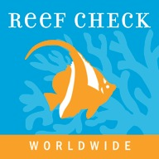
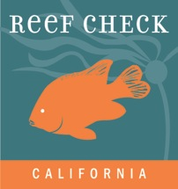
Reef Check
Tracking the health of California’s
rocky reef ecosystems
www.reefcheck.org
Notes:
Hi my name is xyz and I love to scuba dive/surf at <name place> here in California.
Today (night) I’m going to share some stories about what California has done to protect its nearshore marine life – and then I’d like to tell you about how Reef Check and citizen scientist divers like myself help ocean conservation here.
Start out with a short personal story or a question to the audiences

Slide 2
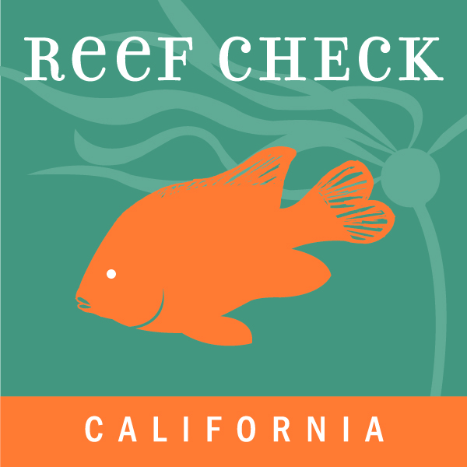
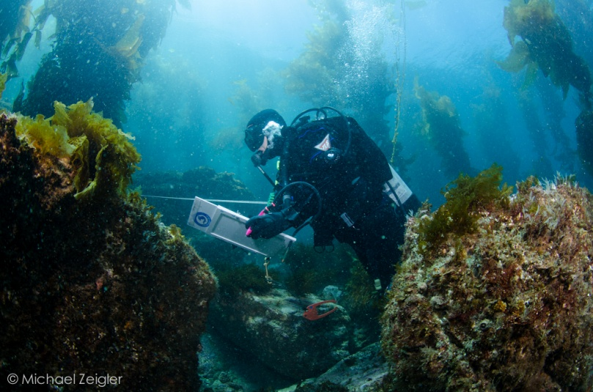
Reef Check
Goals
Provide data to inform marine management and policy
Foster educated constituency for science–based ocean stewardship
Inform management - not advocate
Notes:
Trains volunteer scuba divers as citizen scientists to monitor rocky reefs & kelp forests
Provide data to inform marine management and policy
Foster educated constituency supportive of science–based management and ocean stewardship
Inform management - not advocate

Slide 3
California jobs and society depend on a healthy ocean
Photo: P. Colla – oceanlight.com
Notes:
They support commercial and sport fishing industries, local tourism-based economies, and boundless recreational opportunities.
And they are gorgeous.

Slide 4
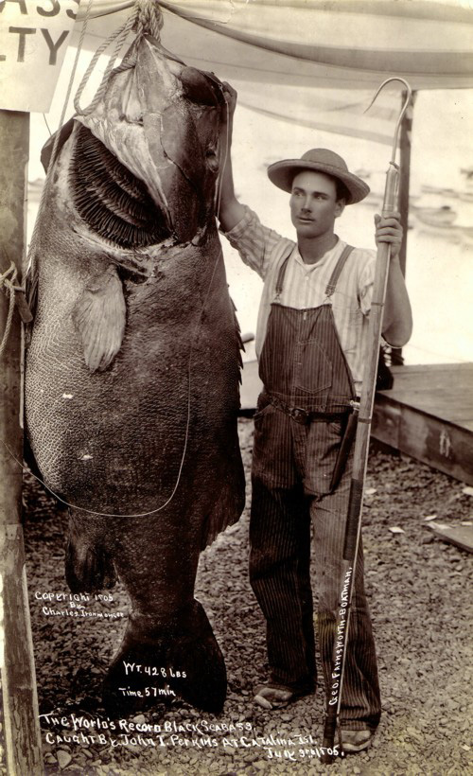
What's beneath the waves
Much less big fish than in the 1950s
West coast bottom fish fishery collapse
Notes:
This is a photo of a giant sea bass – we do not see these anymore. California’s oceans are in trouble, and not the same as they were 100 years ago. Like other places around the world, our ability to extract from the ocean has not caught up with the ocean’s ability to replenish itself.
Over the past 50 years, growing fishing pressure and habitat loss have strained California’s marine systems. In 2000, the U.S. Secretary of Commerce declared the West Coast groundfish fishery a "disaster.” People realized– we’ve got to do something.

Slide 5
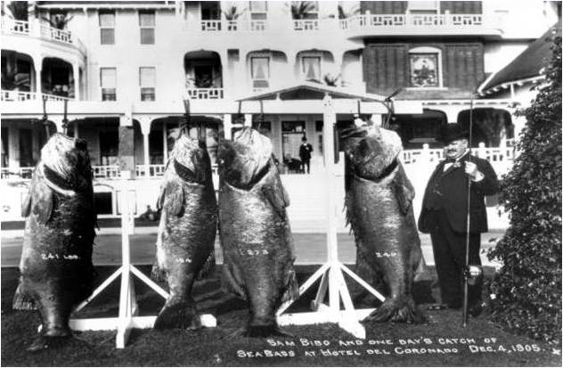
What's beneath the waves
Much less big fish than in the 1950s
West coast bottom fish fishery collapse
Notes:
This is a photo of a giant sea bass – we do not see these anymore. California’s oceans are in trouble, and not the same as they were 100 years ago. Like other places around the world, our ability to extract from the ocean has not caught up with the ocean’s ability to replenish itself.
Over the past 50 years, growing fishing pressure and habitat loss have strained California’s marine systems. In 2000, the U.S. Secretary of Commerce declared the West Coast groundfish fishery a "disaster.” People realized– we’ve got to do something.

Slide 6
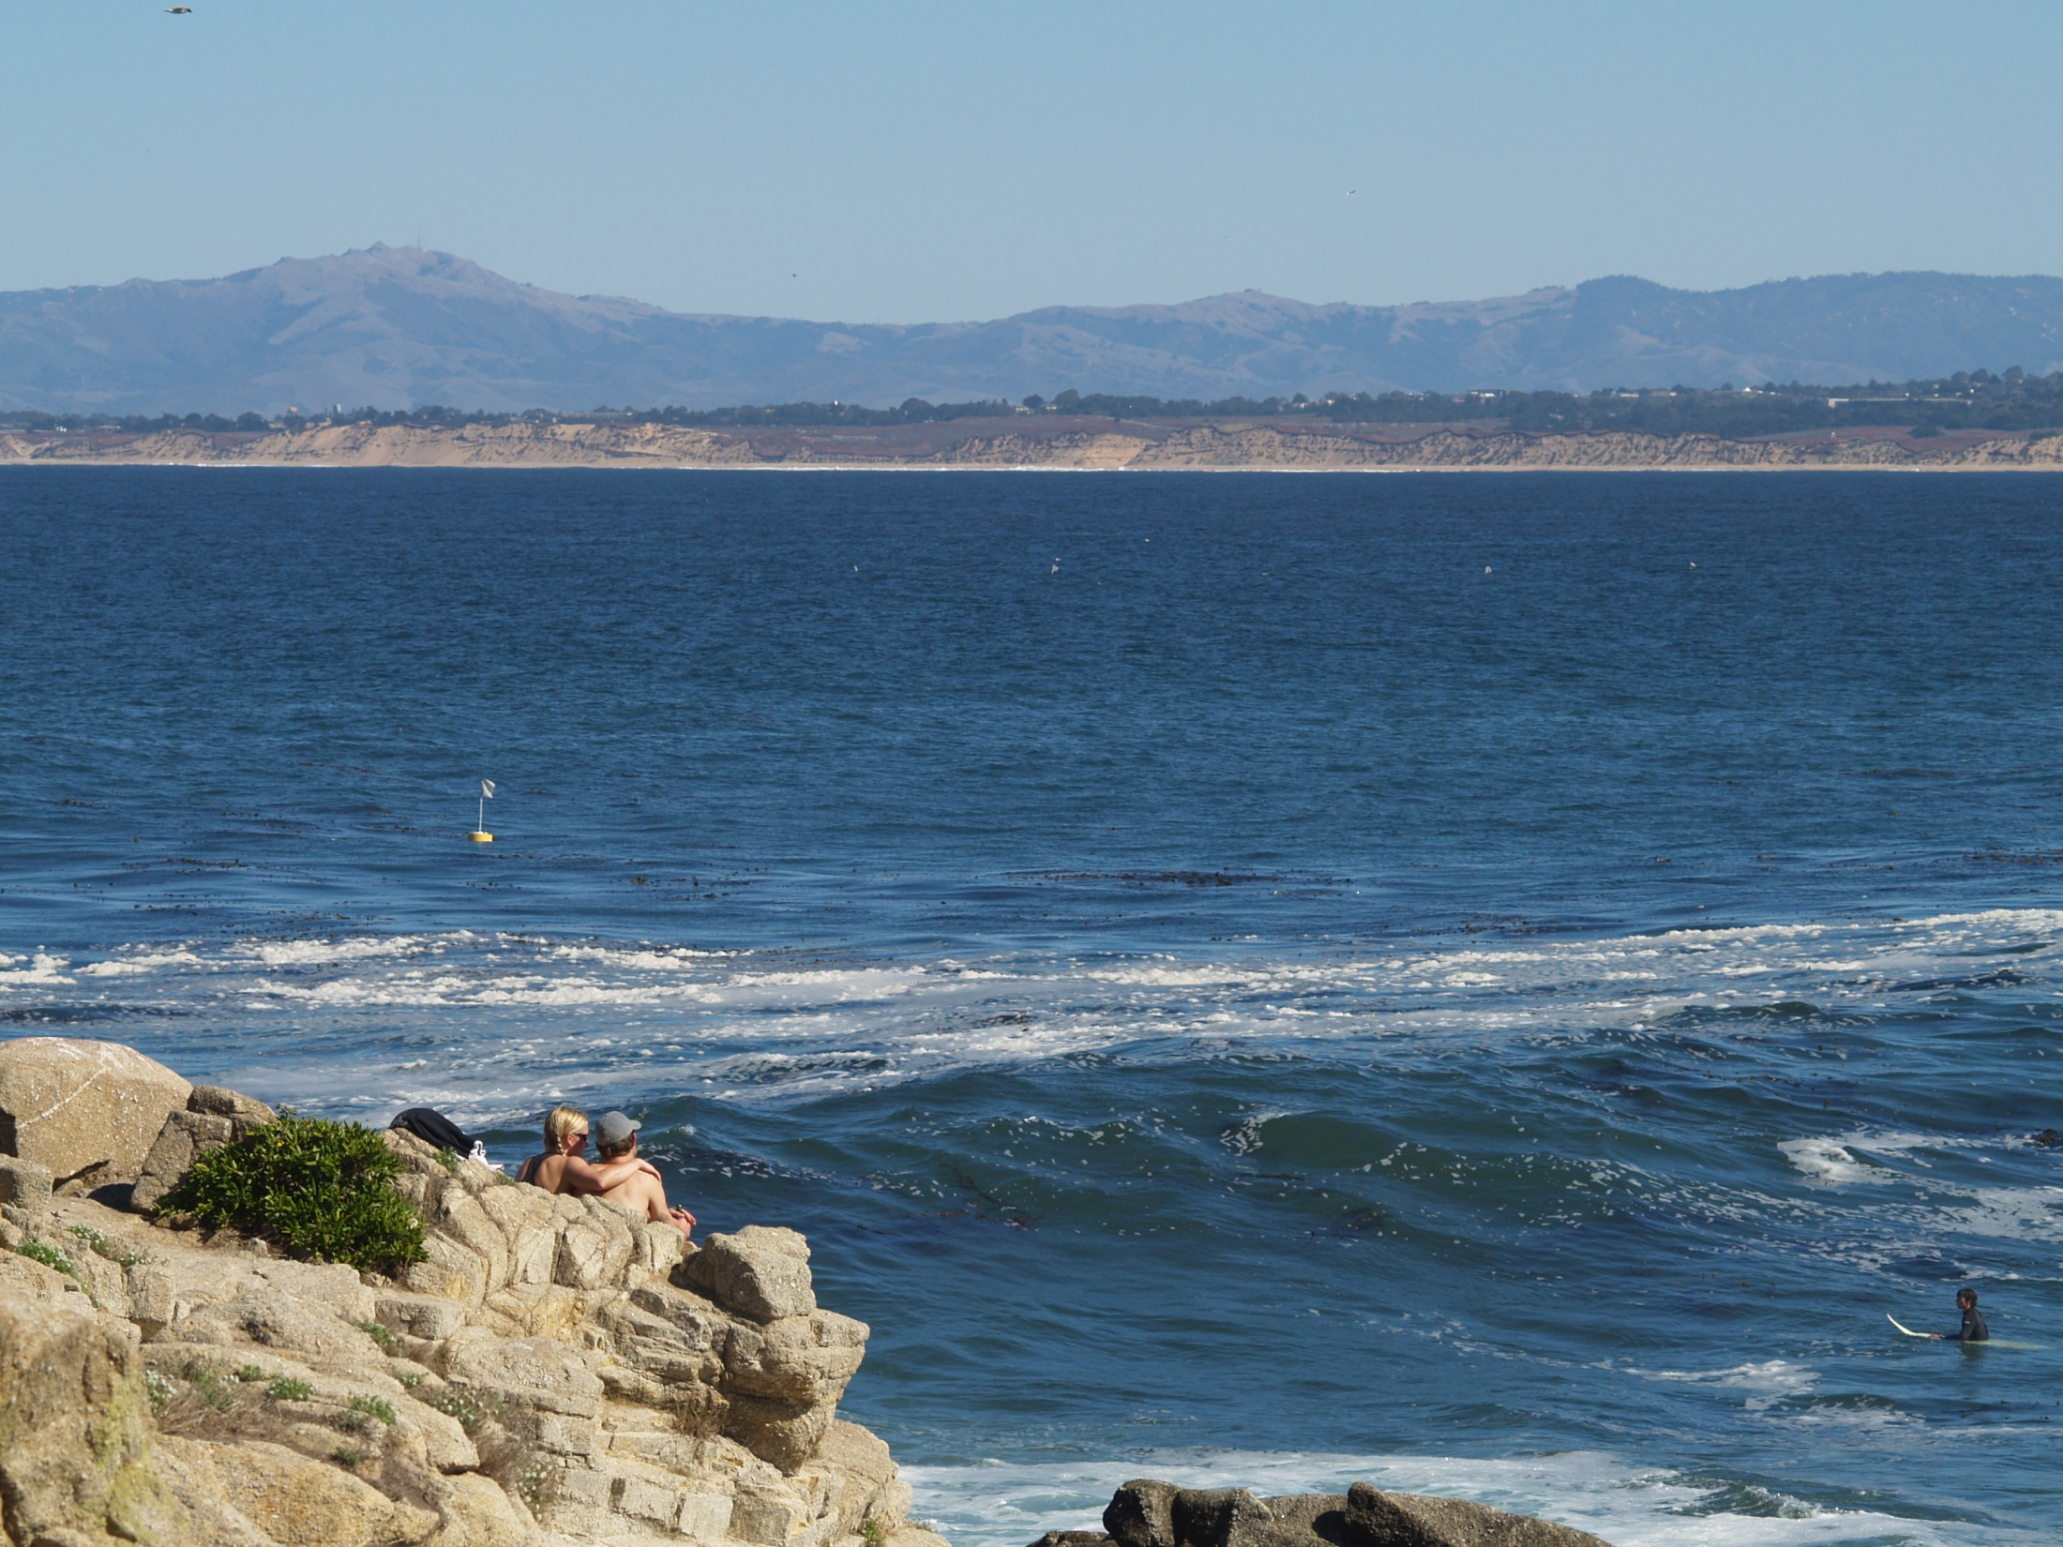
Historic data to inform long-term trends
How have populations of nearshore rocky reef fishes changed over the last 40 years?

Slide 7
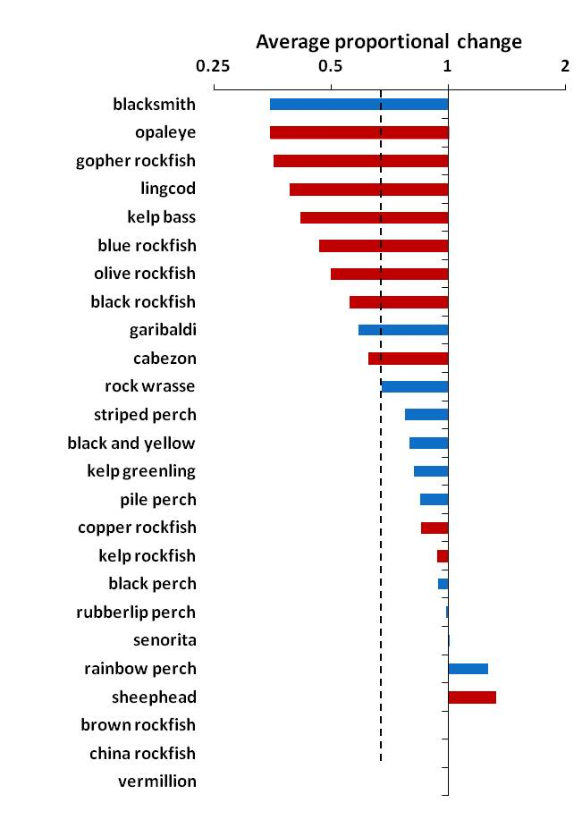
Statewide decline since 1970s
decrease
increase
100%
50%
100%
Average changes at five sites:
Most species declined over last 40 years
Largest declines in fished species
Average population declined about 25%
heavily fished
less fished
average change
Historic data form: Miller & Geible 1973, Hallacher & Roberts 1985, Ebeling et al. 1980, Stephens et al. 1984

Slide 8
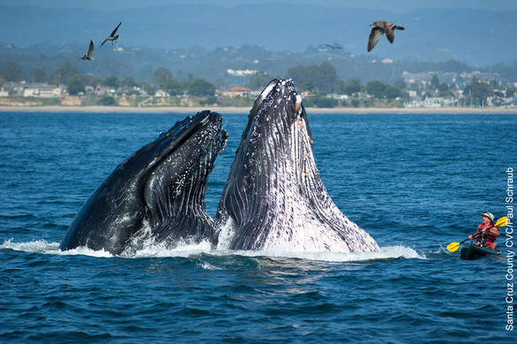
Notes:
OK – now back to California. Who has seen this photo? This was taken in 2011 when a pod of humpbacks were feeding right offshore of Santa Cruz, California.
While its easy to get depressed by the negative headlines and the sense that environmental problems are escalating, there are marine conservation success stories.
For example, humpback whales were hunted and their population fell by an estimated 90% before a whaling moratorium was introduced in 1966. Stocks have since recovered and there are now an estimated 20,000 humpbacks on the North Pacific.
Worldwide the populations are at 35-40% of their original populations (pre-hunting) and in the north Pacific they are thought to be close to what they were before they were hunted

Slide 9
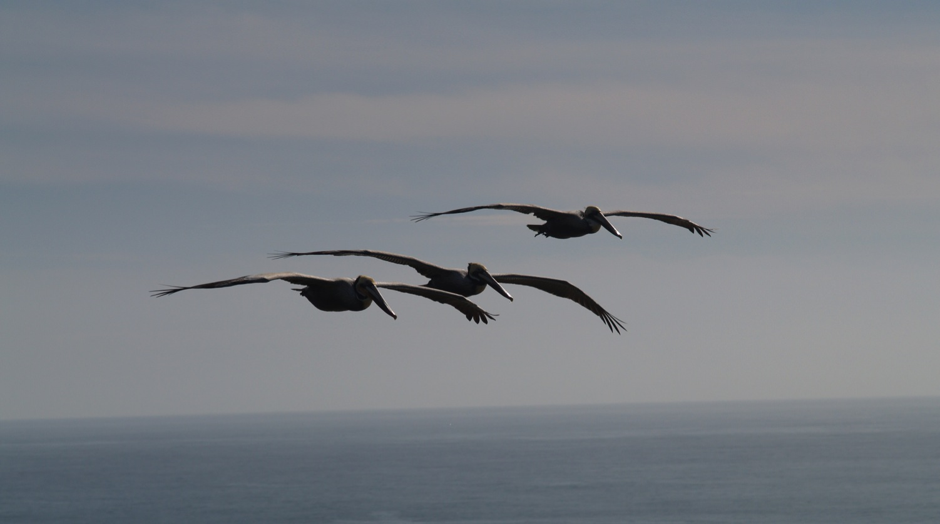
Brown pelicans
Back from the brink
Notes:
The brown pelican is another living symbol of a successful recovery effort.
They nearly became extinct in North America by the 1970s because of the pesticide DDT entering the food chain.
Following protests by environmentalists and scientists the pelicans made a come back.
(background info for presenter: Brown Pelicans and other birds where heavily affected by DDT. They ingested it with their prey as it accumulated in the food chain. DDT affects the birds ability to produce strong egg shells and eggs of many species would break just from birds brooding on them. This led to breeding failures in many species. After DDT was banned it slowly decreased in the food of these bird species and the Pelican is a great example of how a species can recover when the environmental problem affecting it is addressed.)

Slide 10
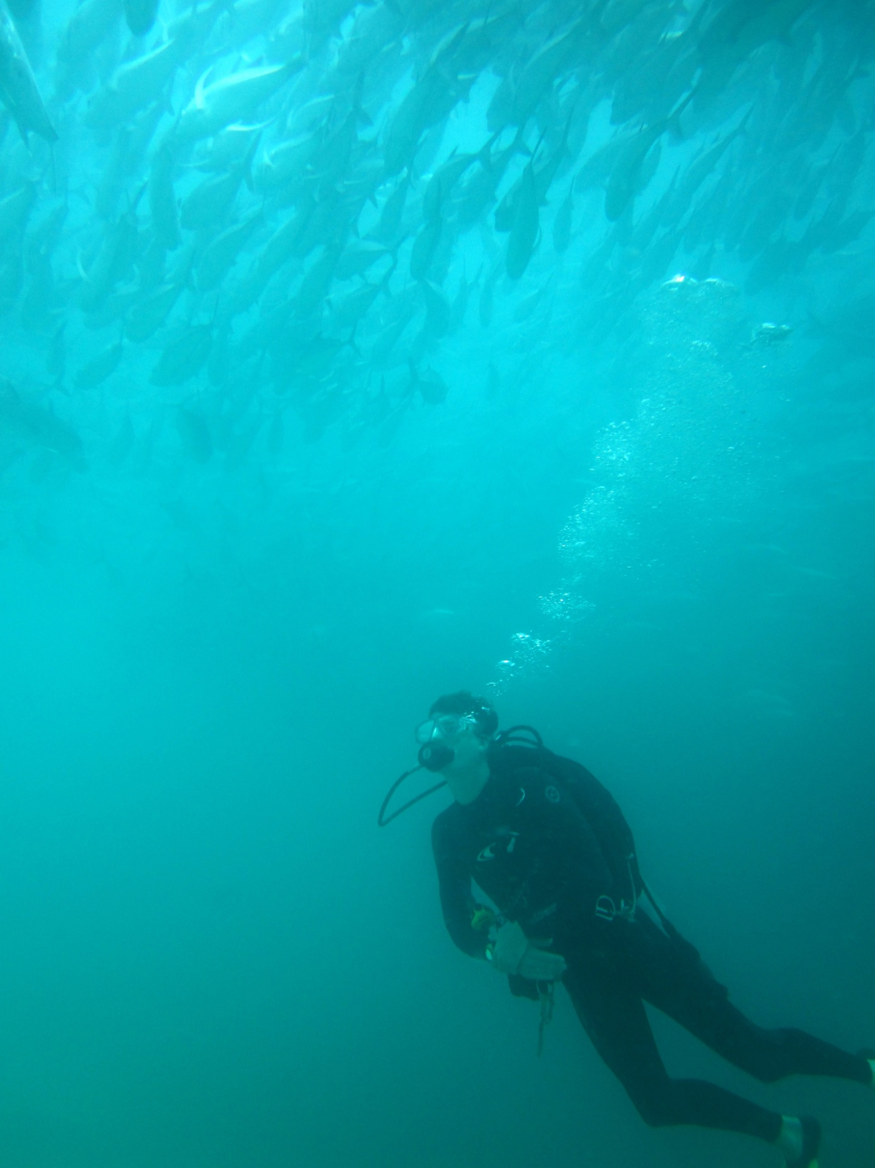
Underwater Parks: Creating Yosemites of the Sea
Notes:
Here in California, we passed the Marine Life Protection Law in 1999, and in Dec. 2012 the statewide network was completed.
We also call MPAs ‘underwater parks’ – like Yosemites beneath the waves – because people can picture that. Otherwise some people think we’re talking about protecting sailors!
More of a story: Everyone loves to visit Yosemite so why not create some thing similar underwater. Over the last 10 years CA has done this. This was a enormous effort involving 1000s of stakeholders and scientists

Slide 11
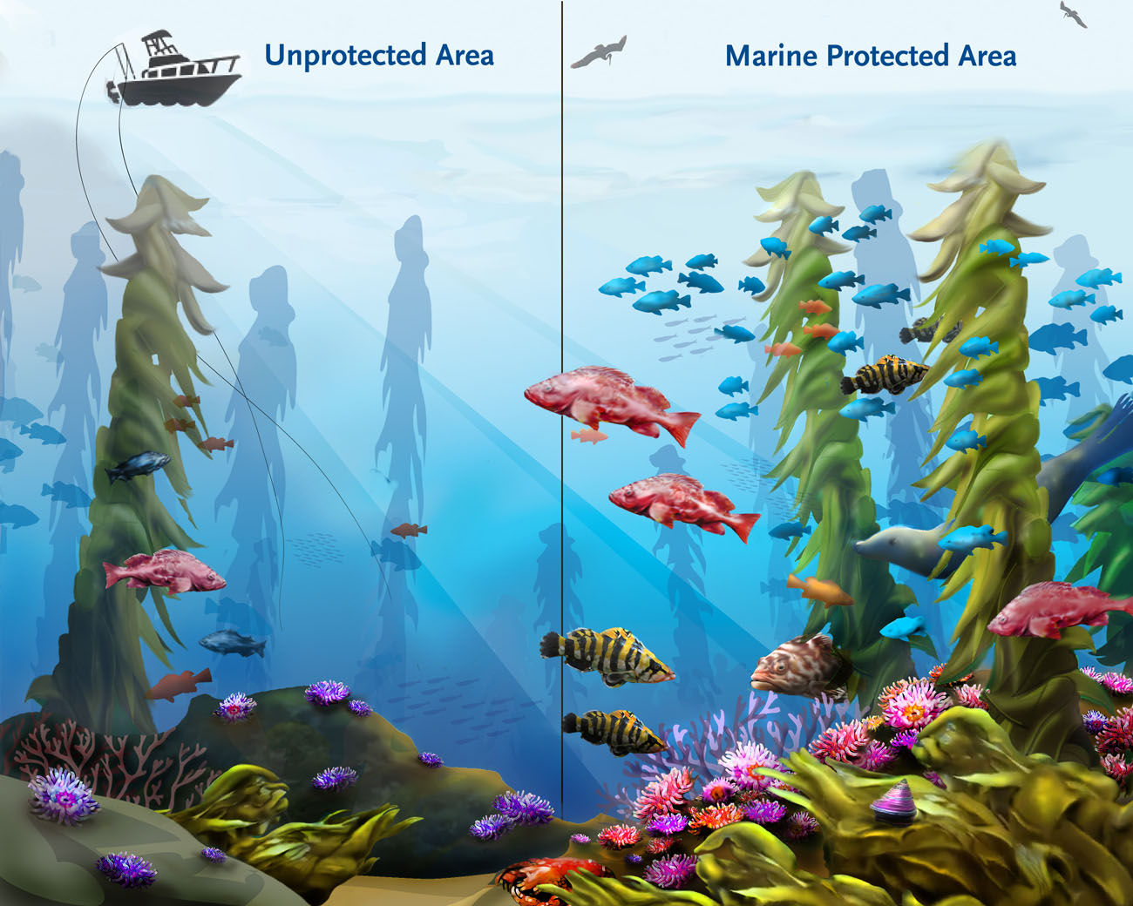
Notes:
How do MPAs work? Scientific studies that have been done around the world prove that by selecting certain areas of the ocean – and protecting them from fishing and hopefully from other impacts – you get bigger fish, more fish, and more biodiversity than fished areas. In a nutshell if we leave the ocean alone, she restores herself.
Talk about growth, reproduction, spill over etc

Slide 12
Notes:
How do MPAs work? Scientific studies that have been done around the world prove that by selecting certain areas of the ocean – and protecting them from fishing and hopefully from other impacts – you get bigger fish, more fish, and more biodiversity than fished areas. In a nutshell if we leave the ocean alone, she restores herself.
Talk about growth, reproduction, spill over etc

Slide 13
California Marine Life Protection Act
Create a Network of MPAs to:
Protect natural diversity and ecosystem functions
Sustain and restore marine life populations
Monitor MPAs to:
Establish benchmark of ecosystem conditions
Detect long-term ecosystem changes

Slide 14
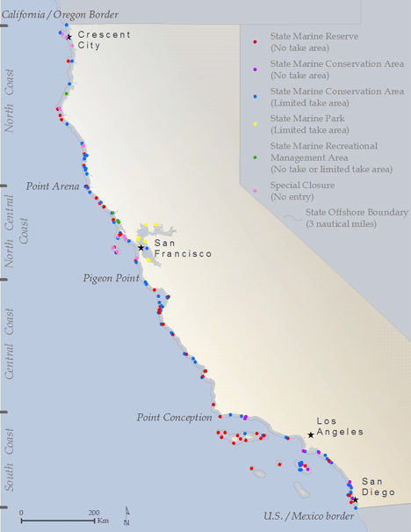
Largest scientifically designed network of MPAs
124 MPAs
16% State waters in MPAs
9% State waters No Take
Notes:
Now California has 124 underwater parks with 9% of state waters now closed to fishing or collecting.
These marine parks are located in remote areas and near cities.
This slide provides the opportunity to talk about local MPAs depending on where the presentation is given and we can provide different maps to localize the presentation if needed. It would also be good to provide the speaker with some detailed information on the MPA implementation process, stakeholder participation, regional approach and the scientific guidelines for MPA size, Network spacing and inclusion of representative ecosystems that were used…they don’t need to talk about it but these are important aspects of how the MPAs came to be and there will probably be questions about this.

Slide 15
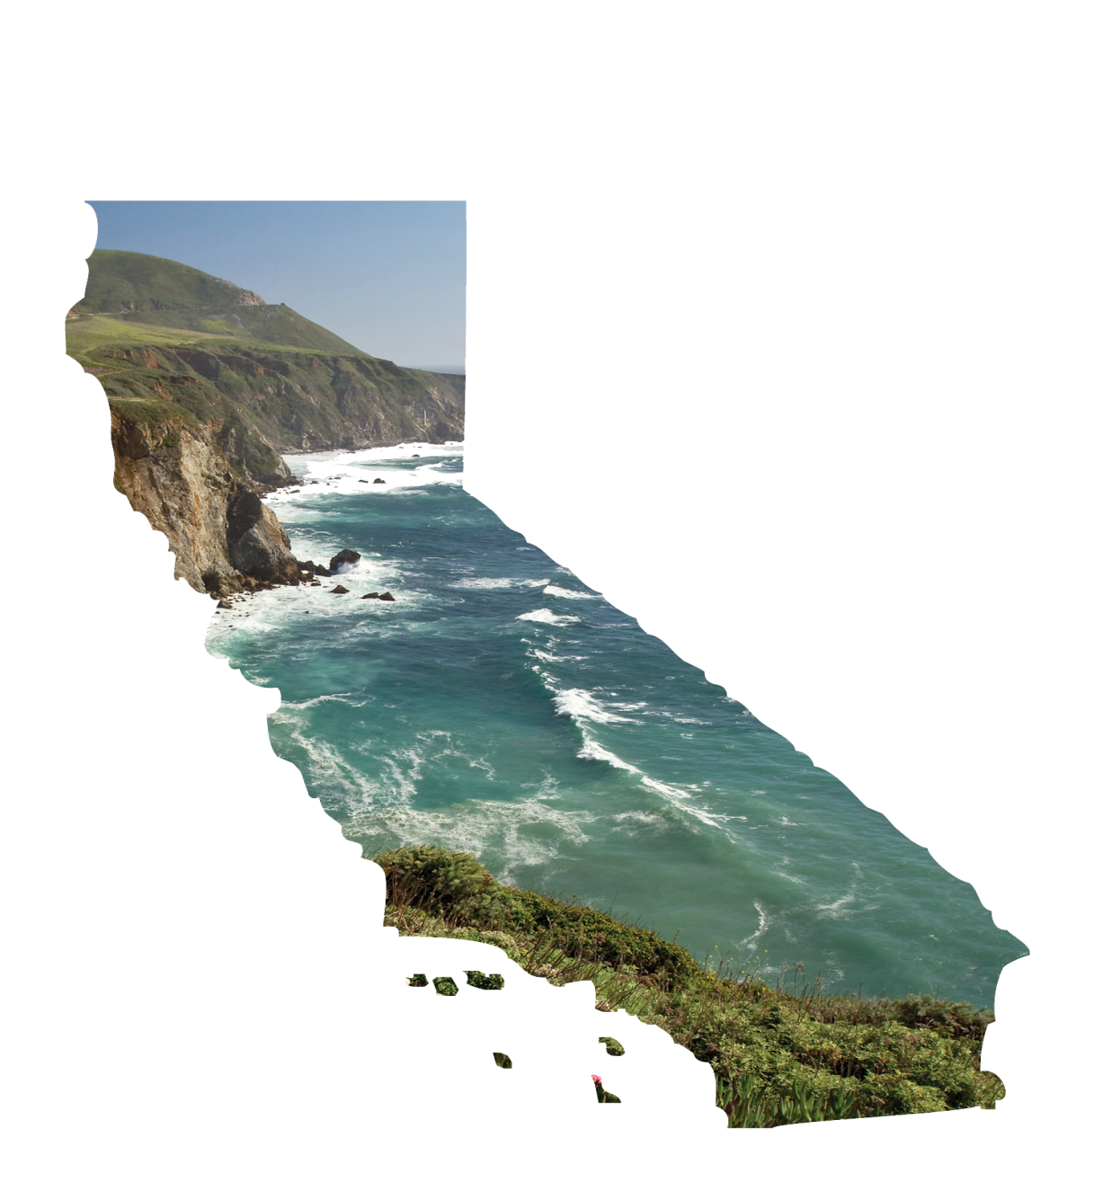
Benefits of underwater parks
Legacy
Healthy, productive oceans for the future
Big Fertile Old Female Fish
Big fish equals more babies → more fish
Biodiversity
Protecting the ocean’s web of life – climate change
Fun!
Underwater parks are for swimming, diving, kayaking and wildlife viewing
Notes:
Here’s what underwater parks do for Californians.

Slide 16
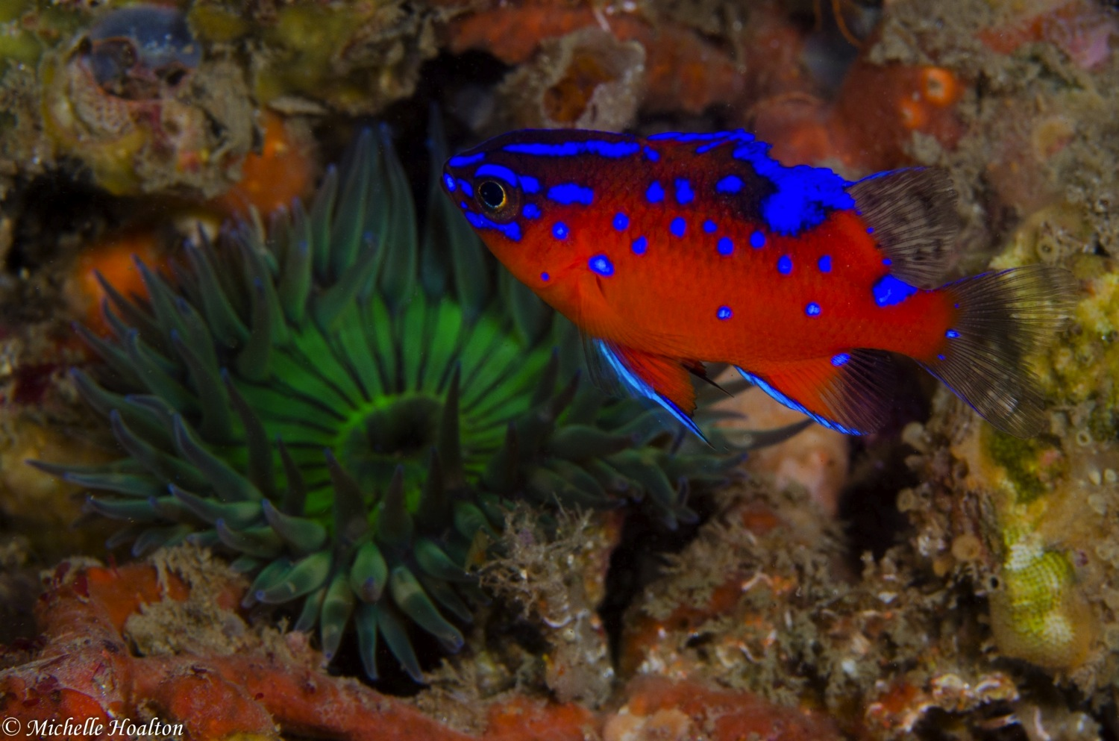
Where does Reef Check come in?
Notes:
Now that the MPA network has been set up in California,
Reef Check participates in monitoring efforts that evaluate their progress.

Slide 17
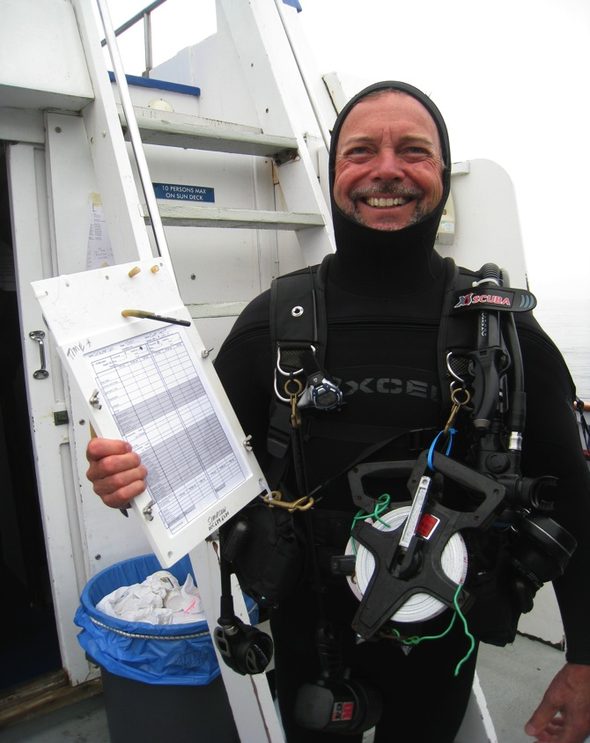
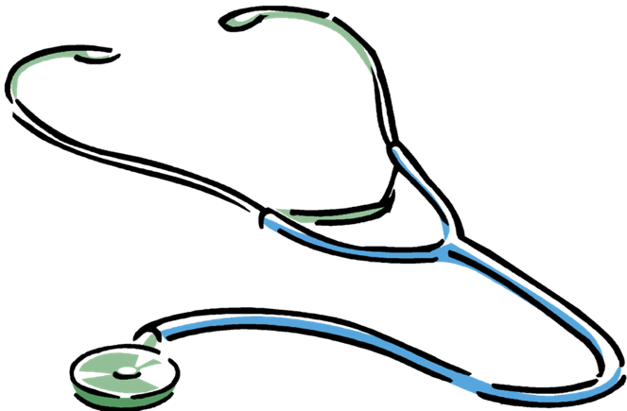
Checking the health of rocky reefs
How do I check the health of the ocean?
Notes:
But how do we monitor the health of a reef ecosystem (or MPA) in California?
How do we check the blood pressure, body temperature and pulse of a rocky reef ecosystem?

Slide 18
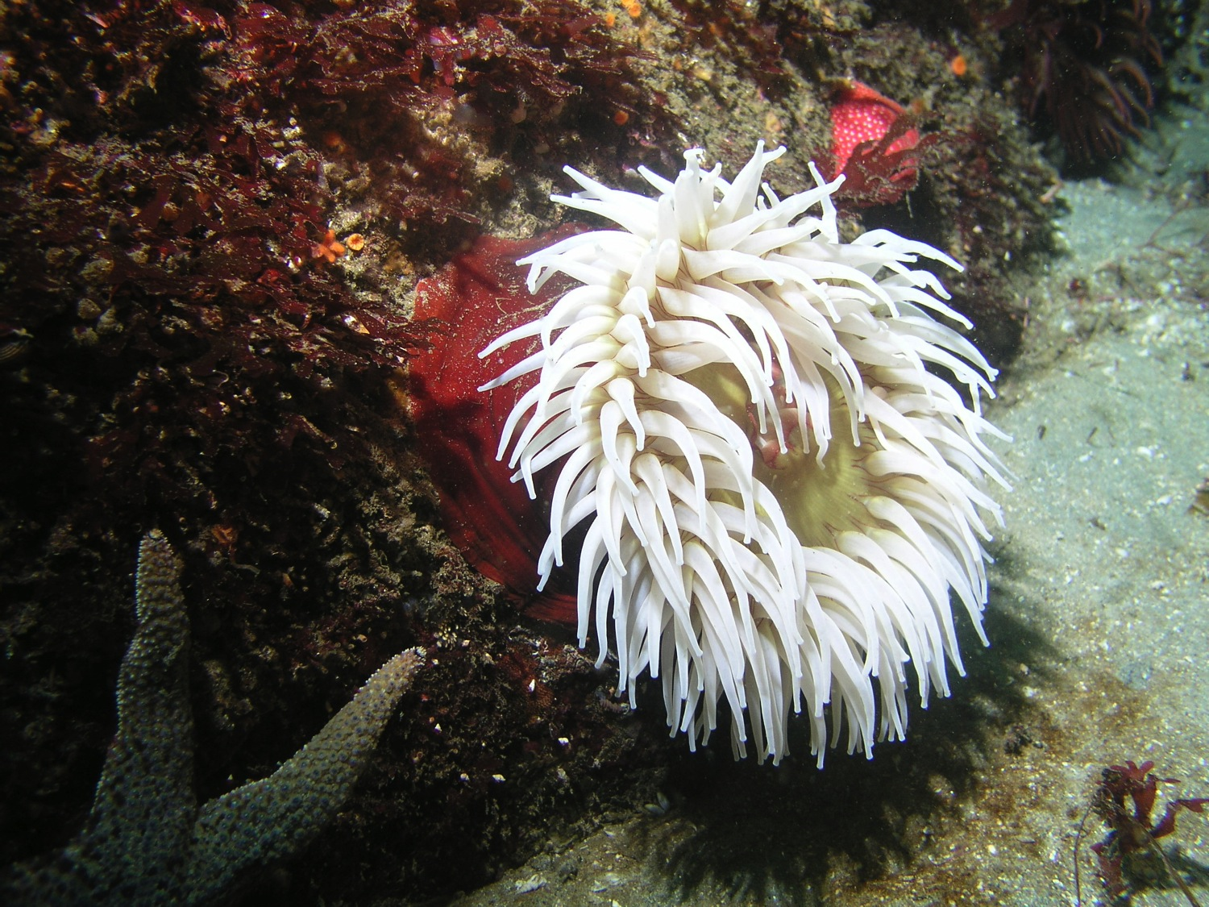
Characteristics of a healthy rocky reef ecosystem
1. Abundant populations
2. Large individuals
3. Intact food webs
Notes:
Ecosystems complex -- so measuring their health is not easy.
A healthy rocky reef ecosystem should have:
Abundant fish, invertebrate and plant species.
There should be large fish and shellfish as well as small ones particularly of those species that are high-value targets for fishing and collecting.
All parts of the food web should be functioning including producers, herbivores, prey and predators. Exploited systems often lack predators because these are targeted first by fishermen.
So to understand if an ecosystem or protected area is healthy we need to look for these indicators.

Slide 19
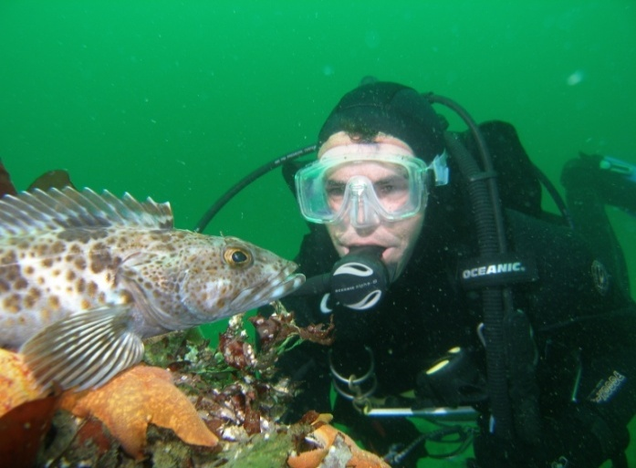
Monitoring basics
Count important species, record their size
Characterize reef habitat
Repeat monitoring to detect change over time
Notes:
Just like the tropical program, Reef Check selected a set of California indicator species that could be counted and in some cases measured to judge reef health.
Reef Check’s monitoring is repeated every year so that we can track changes in the reef and kelp forest communities. To monitor how well the MPAs are doing, we survey inside and outside the MPAs to compare fished and unfished communities.

Slide 20
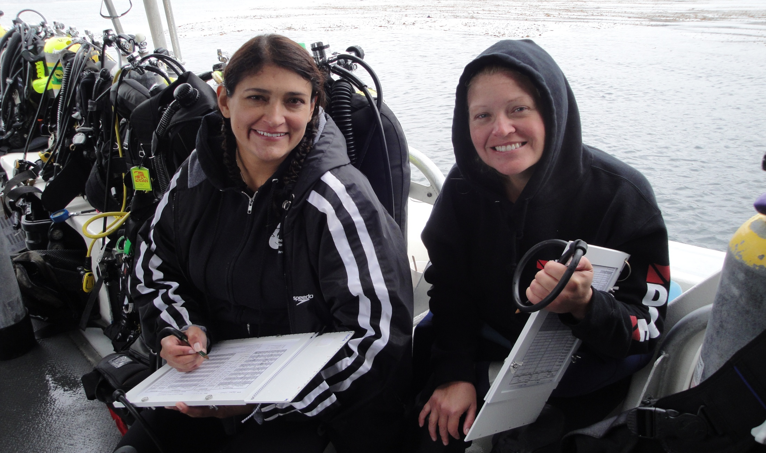
Reef Check monitors California's reefs with citizen scientists
Notes:
Reef Check California trains citizen science divers to provide scientific data that informs the management of these marine reserves. In short, we put California’s ocean fans underwater to take the pulse of the ocean health, and then we report that information back to the state.
Points to make:
Explain who are the trainees
We invite experienced divers to our trainings

Slide 21
Real world scientific training
above and below the waves
4 day classroom and underwater training
ID 73 indicator species
Fish
invertebrates
seaweeds
Learn skills to count and size organisms
Pass tests and joint the team
Notes:
Training takes four days and includes class room lectures and six ocean dives.
Volunteers learn how to identify species, how to size fish and invertebrates such as abalone and sea urchins.
In the ocean they learn the scientific diving skills required to conduct Reef Check surveys.
At the end of the class all trainees must pass written and field tests.
Each year thereafter, our volunteers must past a recertification testing process.

Slide 22
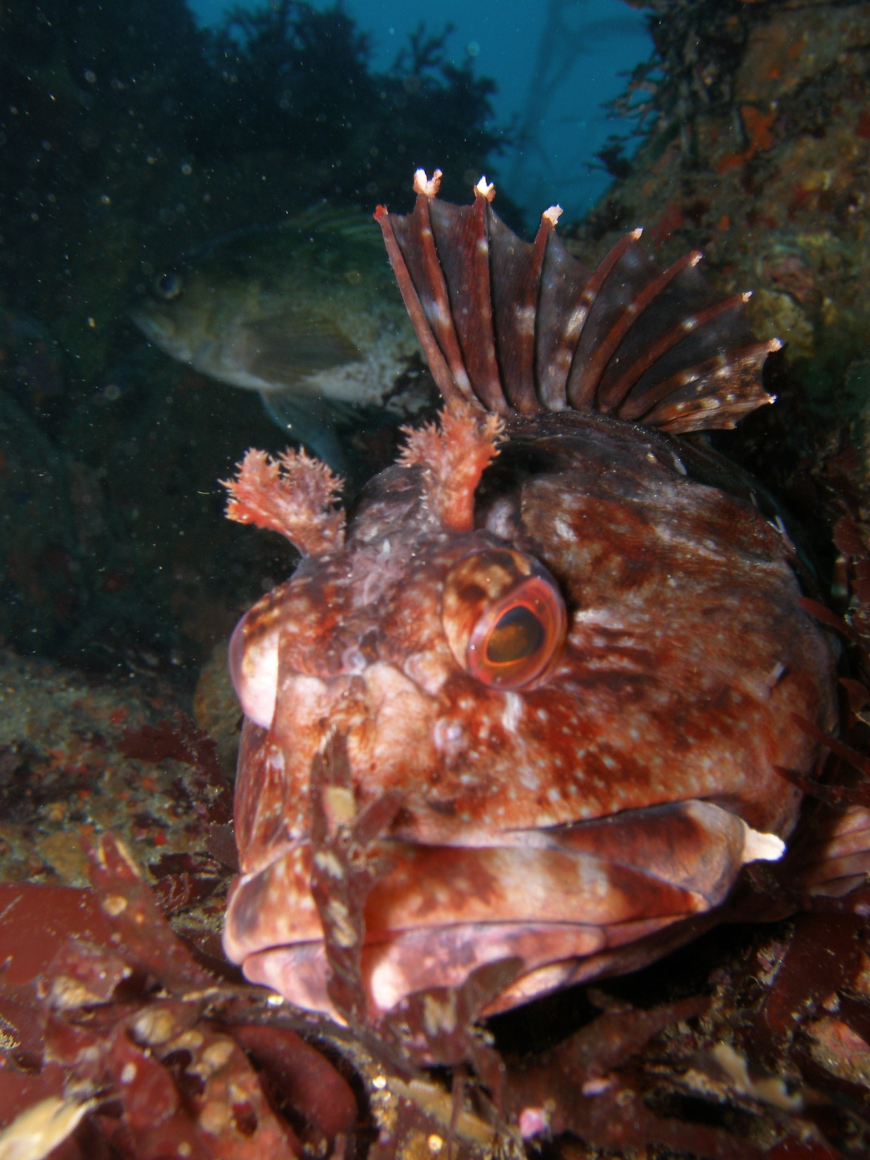
Monitoring Protocol
Stratified random surveys
18 30m long transects/reef

Slide 23
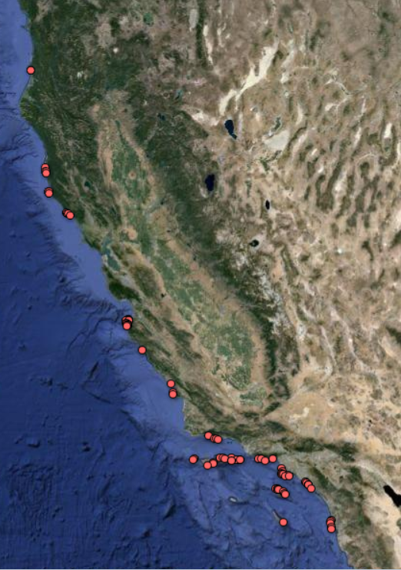
Statewide monitoring program
Eureka
80+ sites
250 active volunteers
Data since 2007
California
San Francisco
Monterey
Los Angeles
San Diego
Notes:
Over the last 7 years Reef Check has built a statewide monitoring program with about 250 volunteers active every year monitoring about 80 sites from Humboldt County to San Diego.

Slide 24
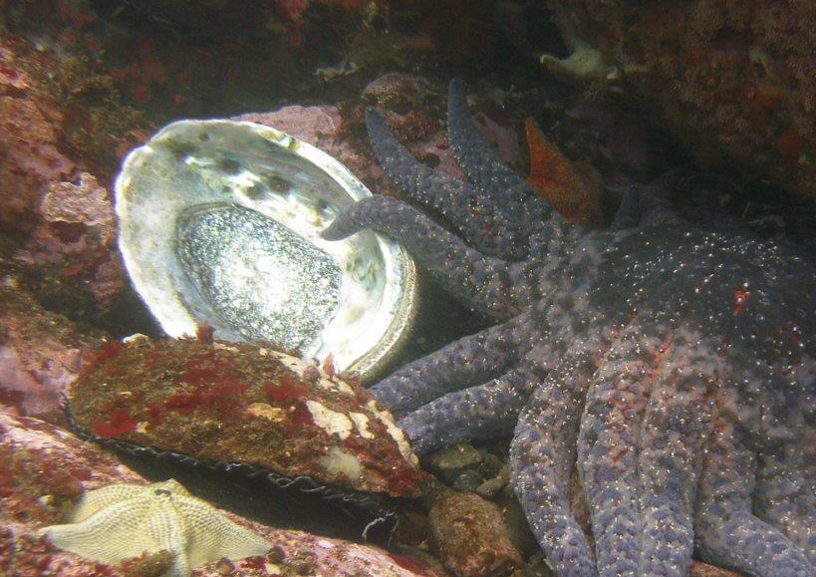
Reef Check divers: watchdogs for
changes in marine health
Notes:
Reef Check can help detect slow long-term changes or rapid major problems.
For example, in 2011 beach-goers began noticing abalone shells washing ashore in large numbers in Sonoma County. Reef Check went underwater to investigate and because of our ongoing monitoring, we could track the dramatic abalone die-off along the Sonoma Coast and compare it with six years of monitoring data. Without ongoing monitoring, this event and its dramatic consequences could not have been tracked.

Slide 25
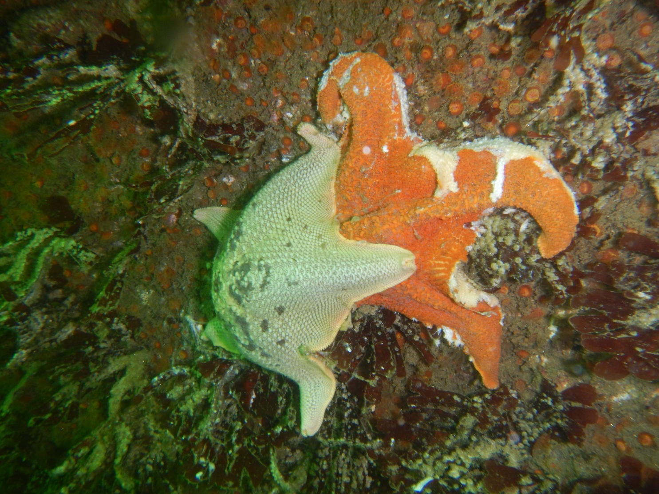
Reef Check divers: watchdogs for
changes in marine health
Notes:
Reef Check can help detect slow long-term changes or rapid major problems.
For example, in 2011 beach-goers began noticing abalone shells washing ashore in large numbers in Sonoma County. Reef Check went underwater to investigate and because of our ongoing monitoring, we could track the dramatic abalone die-off along the Sonoma Coast and compare it with six years of monitoring data. Without ongoing monitoring, this event and its dramatic consequences could not have been tracked.

Slide 26
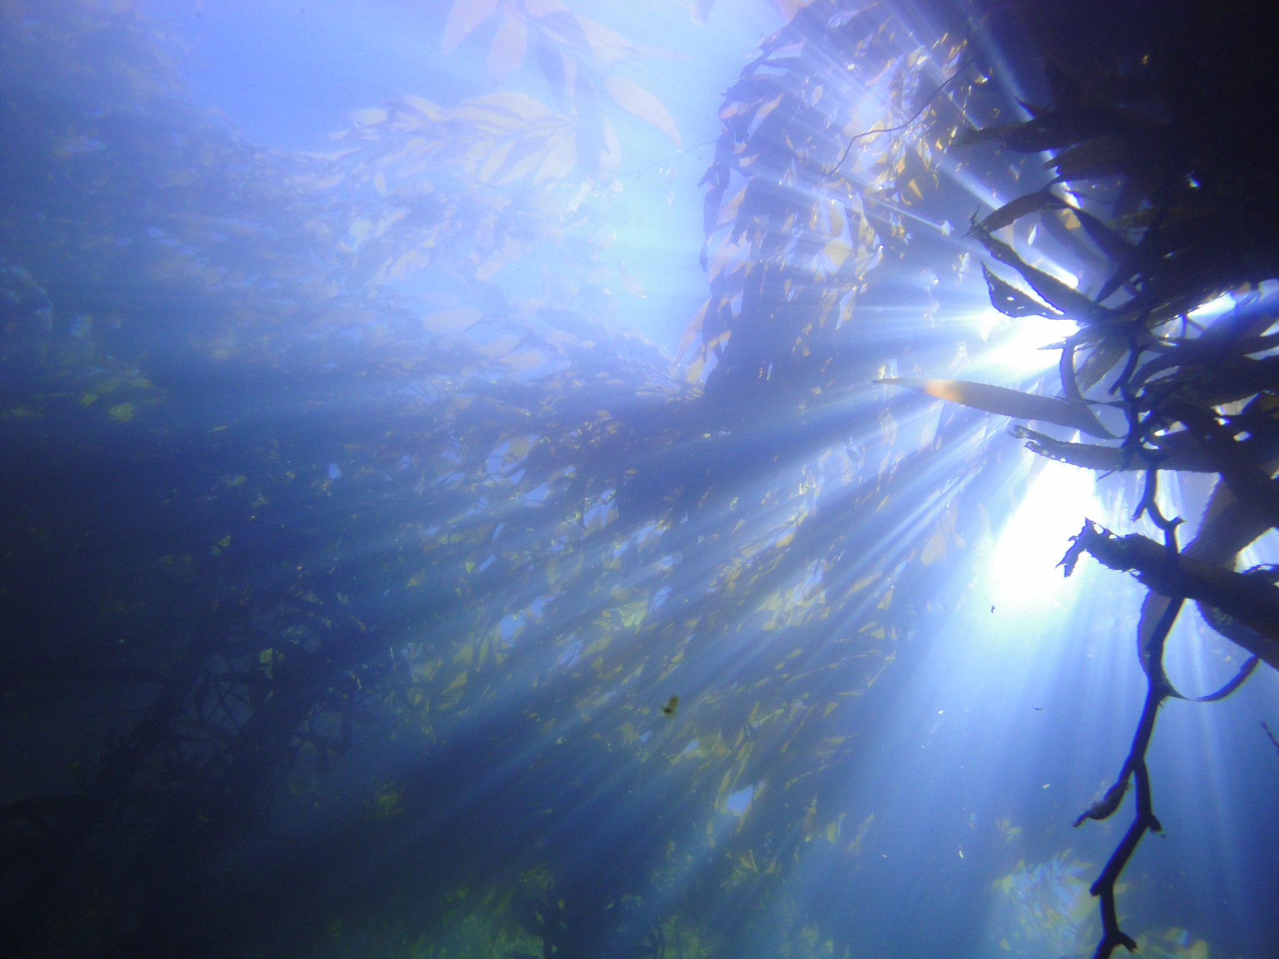
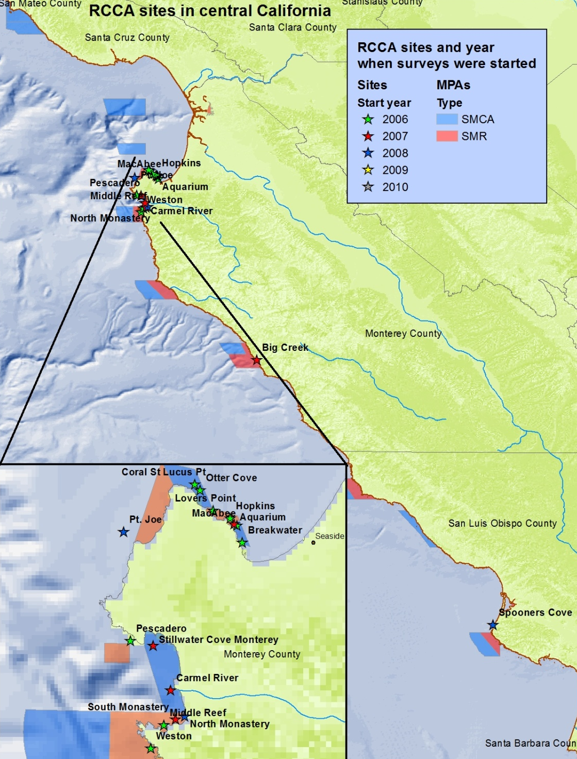
Central Coast Monitoring Sites
MAP Of SITES
Notes:
18 sites
139 surveys between 2006-11

Slide 27
Establishing a benchmark
100
90
80
70
60
3 Kelp Forest Communities
Communities in Monterey differ from communities in Carmel Bay/ Lobos
Notes:
25% differences

Slide 28
Initial change
Density
Compare inside vs. outside of Lover’s Pt. SMR
Some species were already more abundant in SMR in 2007

Slide 29
Initial change
Density
Compare inside vs. outside of Lover’s Pt. SMR
Clear differences in fish densities in 2010
Especially less mobile species show differences
Notes:
Point to make:
All of these species are fished recreationally in the SMCAs around lovers SMR
Most species show a greater difference between SMCS and SMR after 3 years
Especially the species with little movement show greater increase in SMR

Slide 30
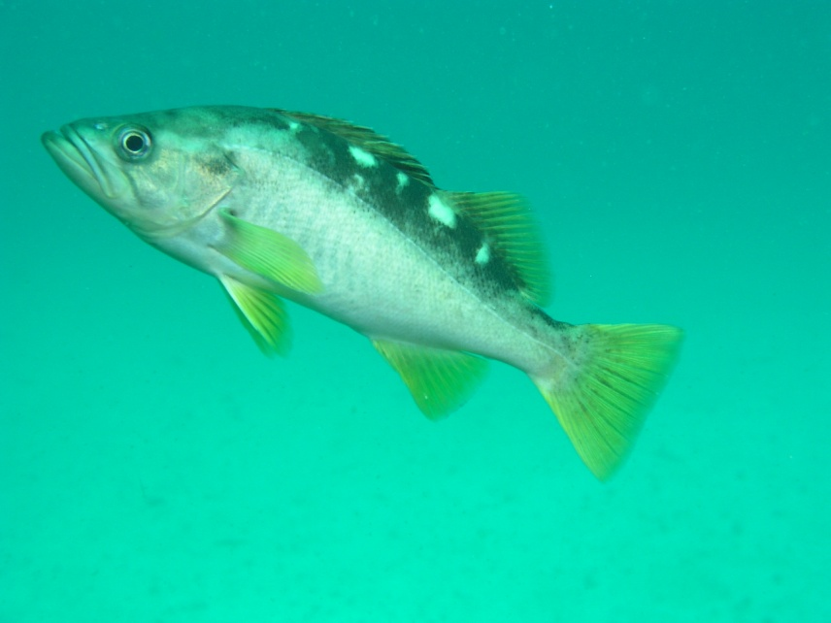
Fish sizes
Size frequencies of species inside and outside of Pt. Lobos SMR
Notes:
lobos

Slide 31
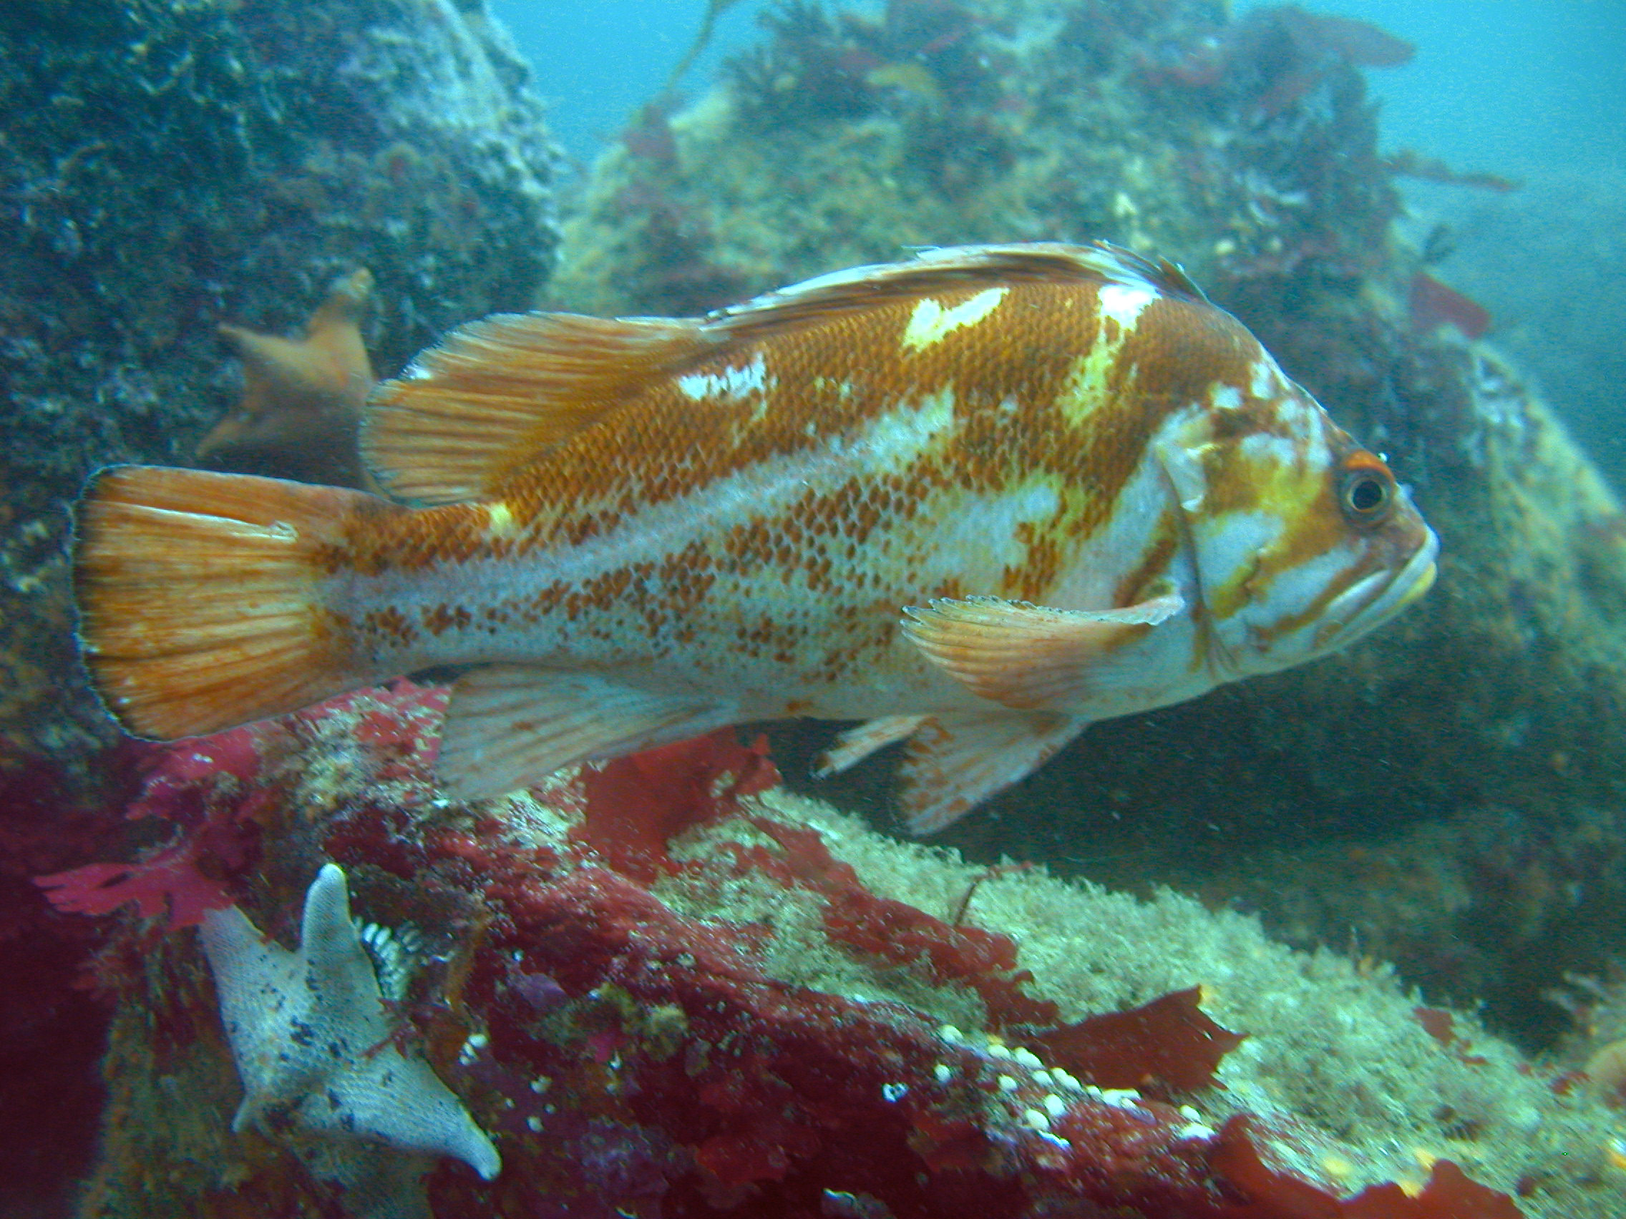
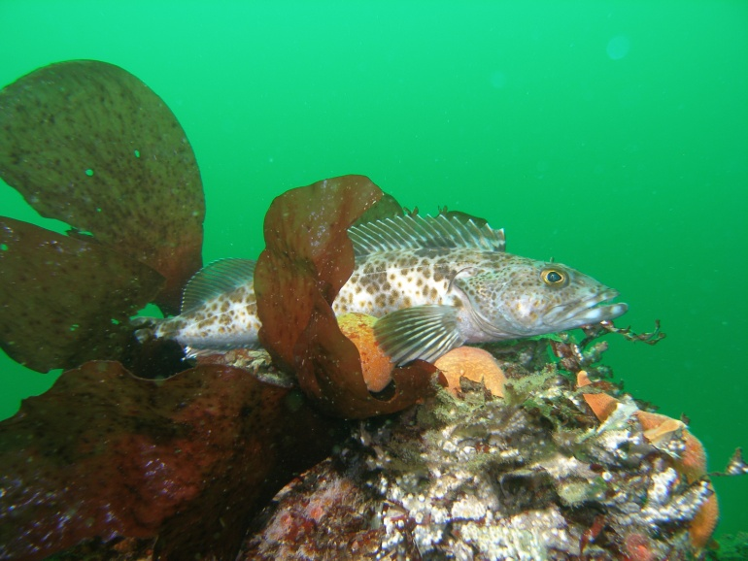
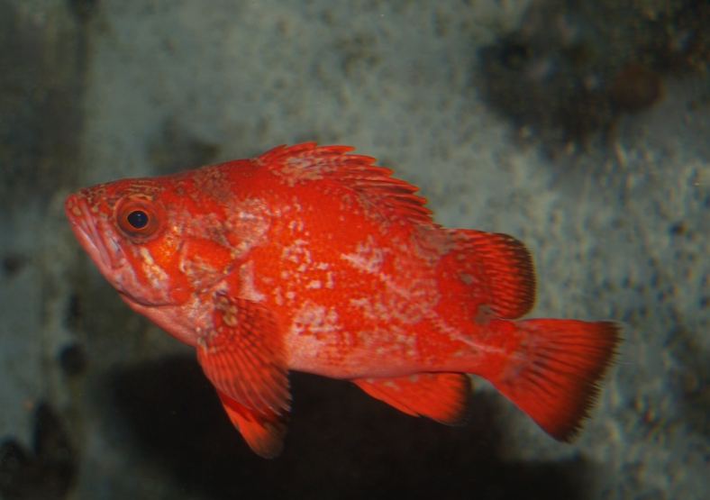
Fish sizes
Notes:
lobos

Slide 32
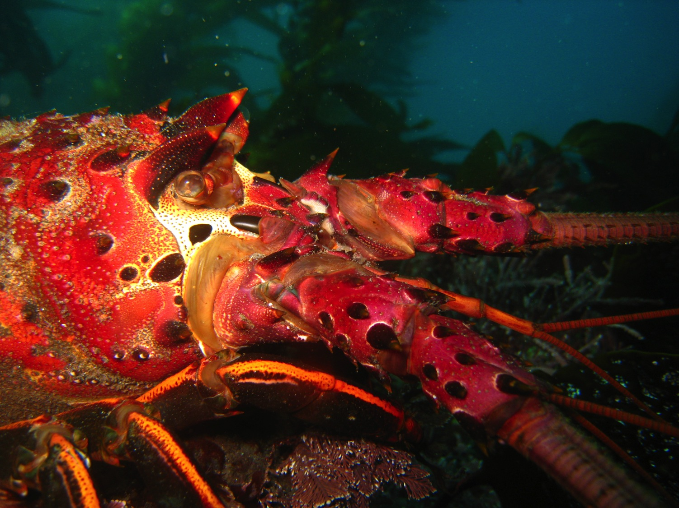
Marine protected areas doing their job
Notes:
I have just shown you one initial MPA success story but there are others.
For example California lobsters –like this one- in the Channel Islands are larger and more abundant after they have been protected in MPAs.

Slide 33
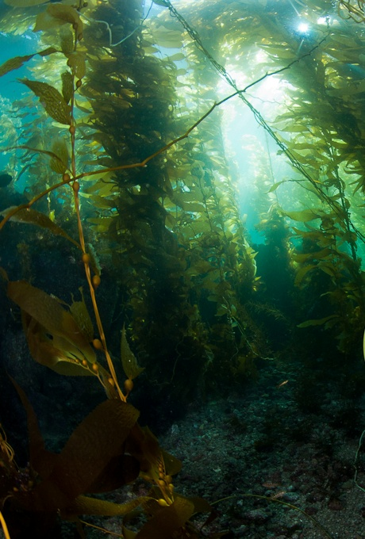
Future of Reef Check’s California program
Train more citizen scientists
Monitor in & outside MPAs
Support California’s marine conservation
Notes:
What is the future of MPA monitoring?
Reef Check will continue to monitor California's MPAs to document changes inside and outside of these amazing underwater parks for the long-term and all the data are available online for the public, students, scientists and managers to study.
This will help everyone evaluate how California’s MPA are doing and if the MPAs are achieving their goals. We will continue to work with the state management agencies to evaluate if the MPAs are protecting the natural ecosystems along our coast and conserve and restore fished species.
This work will become even more important in the light of ongoing climate change and the effects this will have on our ocean environment.
If we don’t systematically monitor our oceans we will not notice changes since they are hidden beneath the waves and out of view of most people.

Slide 34
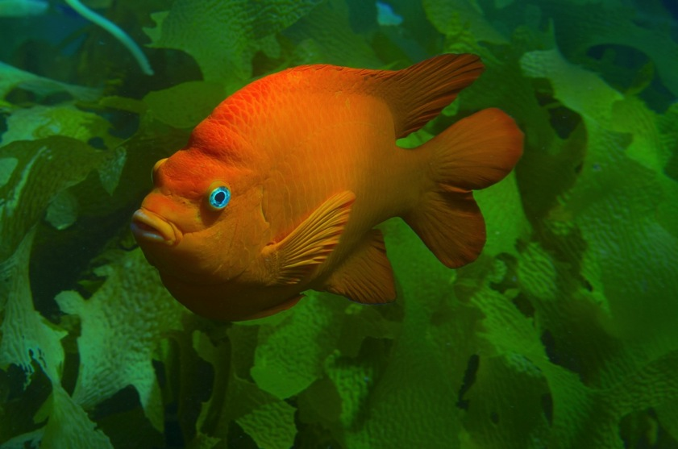
Tell others about California’s underwater parks www.dfg.ca.gov/marine/mpa/index.asp
View Reef Check’s data online
www.data.reefcheck.org
Notes:
Please also help spread the word about California's amazing network of underwater parks. Californians can be proud that we have set aside a part of our coastal ocean for future generations.
And check out more of Reef Check’s data at data.reefcheck.org

Slide 35
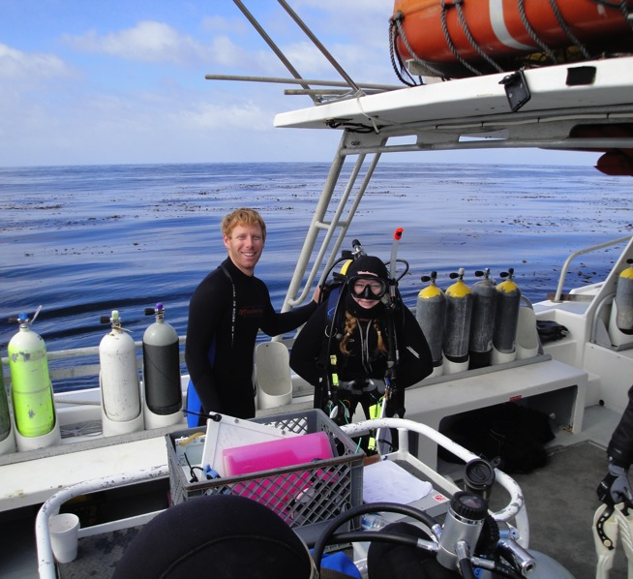
What can you do?
Join Reef Check and support the health of California’s ocean!
You can:
Train to be a Reef Check diver
Volunteer with Reef Check for
important land-based work
Make tax-deductible donations
Notes:
You can join Reef Check and become trained as a citizen scientist.
You can help us in other ways. If you have specific skills that you think might help us do our important work please come and talk to me.
And of course you can make a donation in support of our important work.

Slide 36
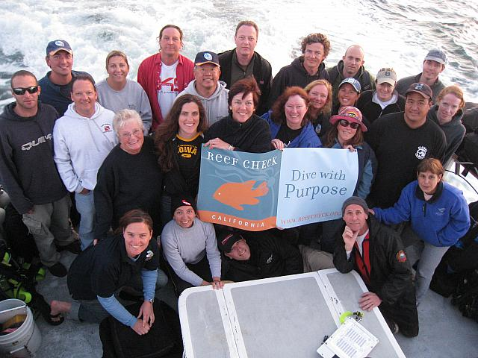
Acknowledgements
Citizen Scientist Volunteers
Current Funding:
Resource Legacy Fund Foundation
Keith Campbell Foundation for the Environment
Lisa & Douglas Goldman Foundation
Ocean Protection Council and State Coastal Conservancy through California Sea Grant
California Coastal Commission’s Whale Tail Fund
Clif Bar Family Foundation
Pacific Life Foundation
UCSB Coastal Fund
Patagonia
Adopt –A –Reef partners

Slide 37
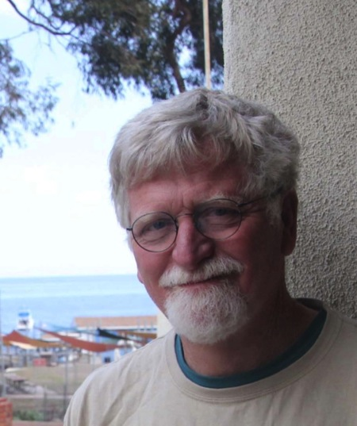
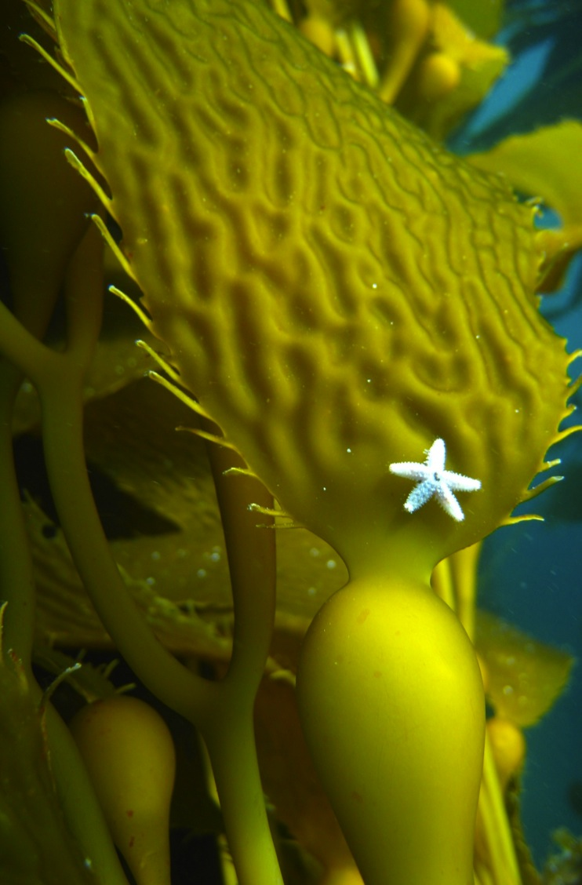
Thank you!
Jan Freiwald
jfreiwald@reefcheck.org
“Reef Check makes me feel hopeful. It is a great program that allows science professionals to network with people like myself who want to do something to help.”
Bill Field -- RC Citizen Scientist
Contractor -- Avrey & Reese Builders, Sebastopol
www.reefcheck.org
Notes:
This is Bill Field – one of our Reef Check divers. We often give up our weekends to carry out surveys. And believe me – the ocean is not always calm and sunny! We always deal with cold water and sometimes big waves, rain, fog and poor underwater visibility. But we love our volunteer work and that is why I am here. Thank you for coming and letting me share our story with you.
I’d be happy to answer any questions.

